Slide 1

ONLINE MEETING SERVICE
Department of Computer Science & Engineering
Gandhi Institution for Education and Technology, Bhubaneswar, Khordha
Submitted By:-
Ujjwal Kumar Dutta (2101326135)
Sangram Dey (2101326109)
Manoj Kumar Jena (2101326076)
Mitesh Kumar Pani (2101326084)
Raj Dandapat (2101326100)
Guided By
Prof:- Dona Chakraborty

Slide 2
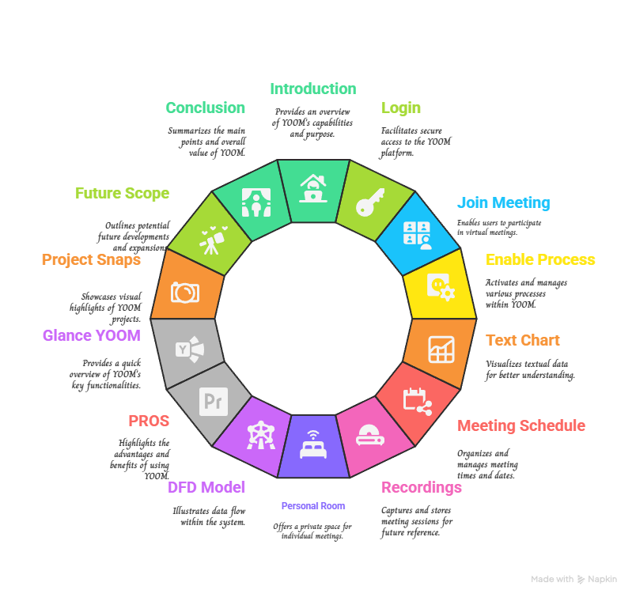
CONTENTS
Technical Stack:-
Frontend:- HTML, CSS, JavaScript, React Backend:- Node , JavaScript
Database:- MONGO DB
Major project Presentation 2025
Organized by: Department of Computer Science & Engineering, GIET, Baniatangi, 752060

Slide 3
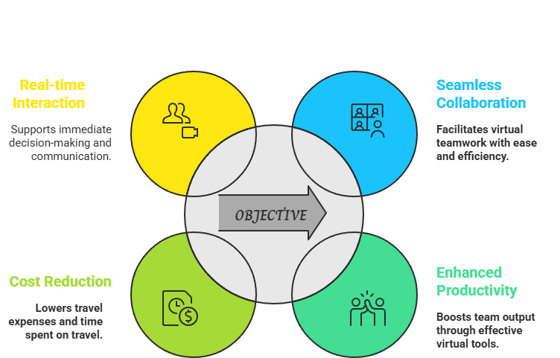
INTRODUCTION
Online meeting services enable virtual communication through platforms that support video, audio, and chat functionalities. They facilitate remote collaboration, connecting individuals and teams across different locations. These services are widely used for business meetings, education, and personal interactions, offering convenience, cost-efficiency, and flexibility in a digital-first world.
OBJECTIVE
Major project Presentation 2025
Organized by: Department of Computer Science & Engineering, GIET, Baniatangi, 752060

Slide 4
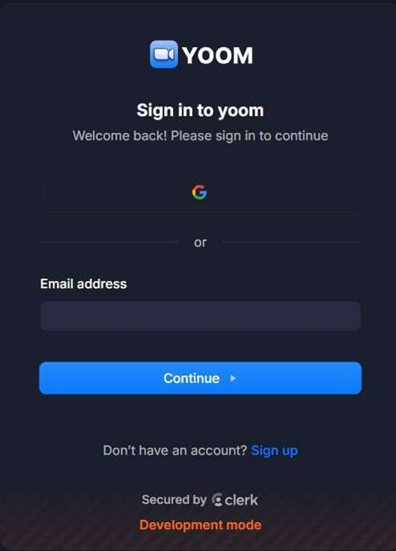
LOG-IN
*Open the Platform*: Launch the service’s app or visit its website (e.g., Yoom,).
*Enter Login Details*: Click the "Sign In" button. Enter your email/username and password.
*Authenticate*: If two-factor authentication is enabled,
verify via a code sent to your email/phone.
*Access the Meeting*: Use the meeting link or enter the meeting ID and passcode (if required).
*Grant Permissions*: Allow access to your microphone and camera when prompted.
*Join*: Click "Join Meeting." You're now logged in and Ready.
Major project Presentation 2025
Organized by: Department of Computer Science & Engineering, GIET, Baniatangi, 752060

Slide 5
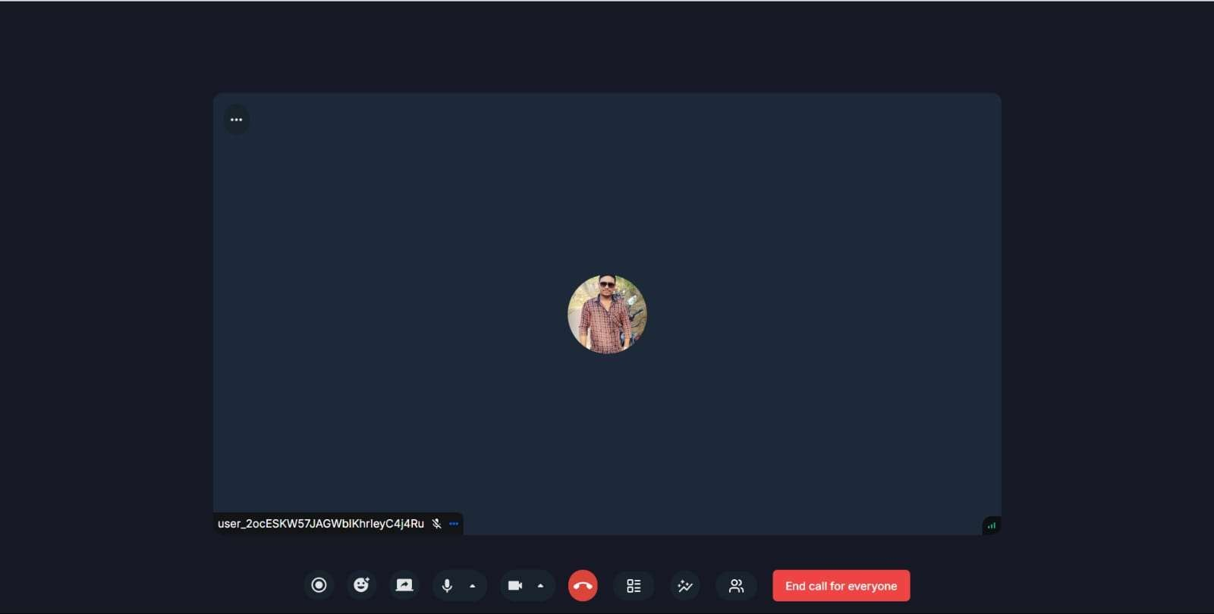
JOIN MEETING
Joining a meeting on an online meeting service is simple and efficient. First, ensure you have the platform's app or browser access.
Click the meeting link provided or enter the Meeting ID and passcode if required. Check your audio and video settings before entering to ensure smooth participation.
Always follow the host's guidelines for a professional experience. Online meeting services make collaboration easy and accessible from anywhere.
Major project Presentation 2025
Organized by: Department of Computer Science & Engineering, GIET, Baniatangi, 752060

Slide 6
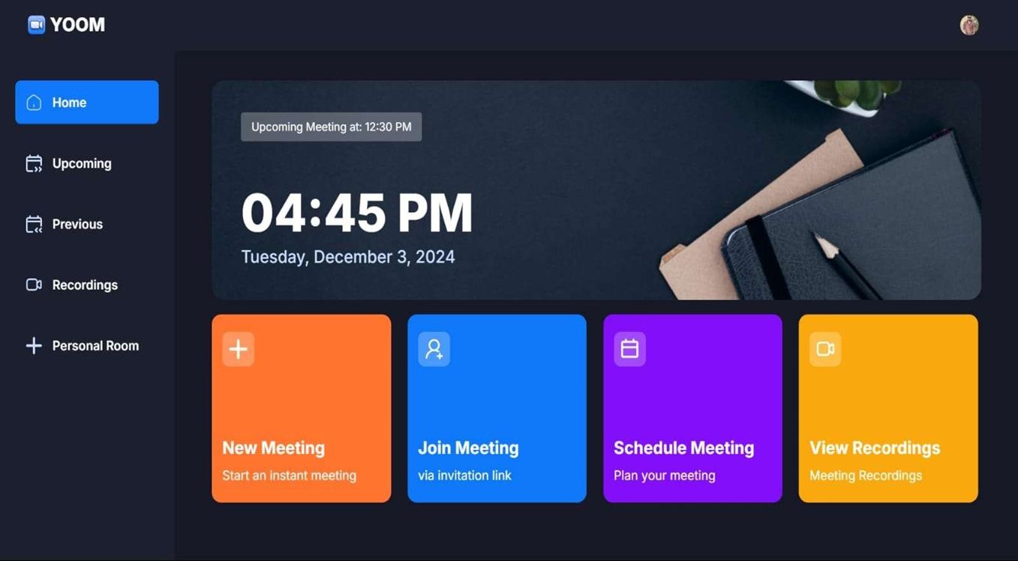
ENABLE PROCESS
*Sign Up/Log In*: Create an account or log in with your credentials.
*Download Software*: Install the app if required, or
use the browser version.
*Set Up a Meeting*: Click "New Meeting" or "Schedule" and provide meeting details (time, date, etc.).
*Share Details*: Share the meeting link or ID with participants.
*Test Equipment*: Ensure your microphone, camera, and internet are functioning.
*Start the Meeting*: Begin by clicking "Start."
Major project Presentation 2025
Organized by: Department of Computer Science & Engineering, GIET, Baniatangi, 752060

Slide 7
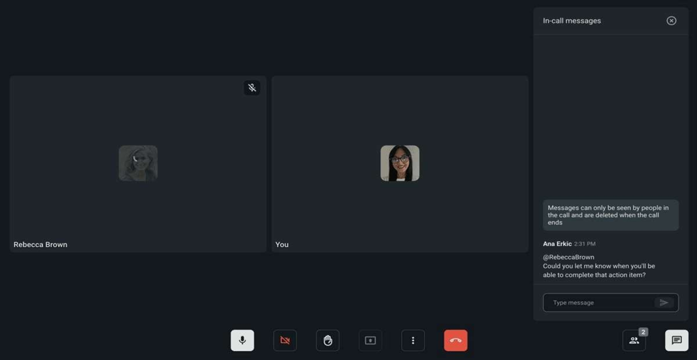
TEXTCHAT
A text chat in an online meeting service is a feature that visually organizes and presents information through text-based elements during virtual discussions.
These chats improve communication by providing a clear, organized overview of complex concepts, aiding in collaboration and decision-making.
Text chats enhance engagement and efficiency, allowing participants to stay focused on objectives while minimizing miscommunication during online meetings, webinars, or collaborative workshops.
Major project Presentation 2025
Organized by: Department of Computer Science & Engineering, GIET, Baniatangi, 752060

Slide 8
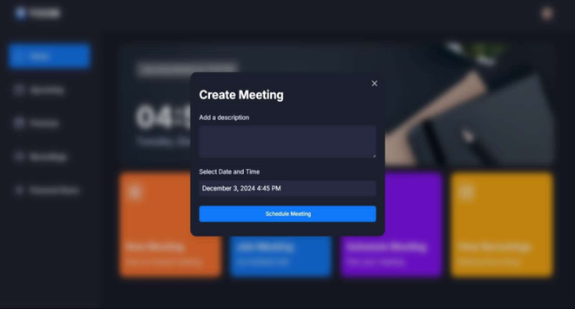
MEETING SCHEDULE
A meeting schedule in an online meeting service is a planned timetable that outlines the agenda, timing, and participants for virtual gatherings.
This schedule is often shared with attendees via email or integrated directly into the meeting platform, allowing participants to prepare in advance.
A well-structured schedule ensures efficient use of time, clear communication, and productive collaboration during virtual meetings.
Major project Presentation 2025
Organized by: Department of Computer Science & Engineering, GIET, Baniatangi, 752060

Slide 9
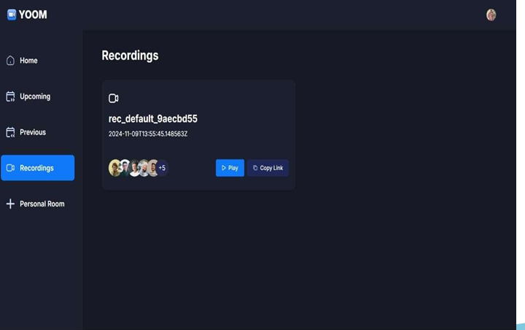
RECORDINGS
Recordings in an online meeting service capture the audio, video, and shared content from virtual meetings for future reference.
Recordings are stored in the cloud or locally, often with options for sharing, editing, or downloading.
Recorded meetings are used for training, compliance, or documentation, promoting transparency and accountability.
Major project Presentation 2025
Organized by: Department of Computer Science & Engineering, GIET, Baniatangi, 752060

Slide 10
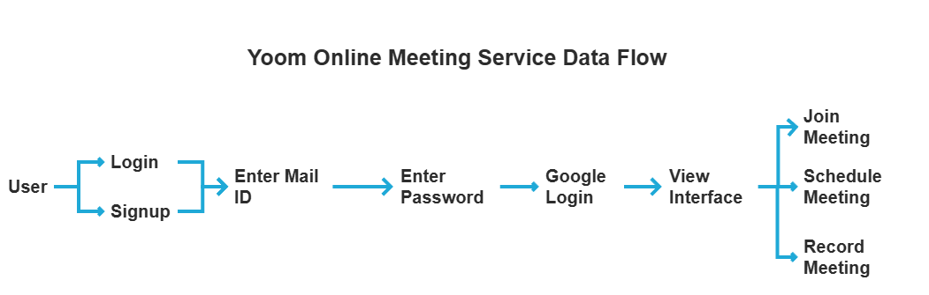
DFD MODEL
Major project Presentation 2025
Organized by: Department of Computer Science & Engineering, GIET, Baniatangi, 752060

Slide 11
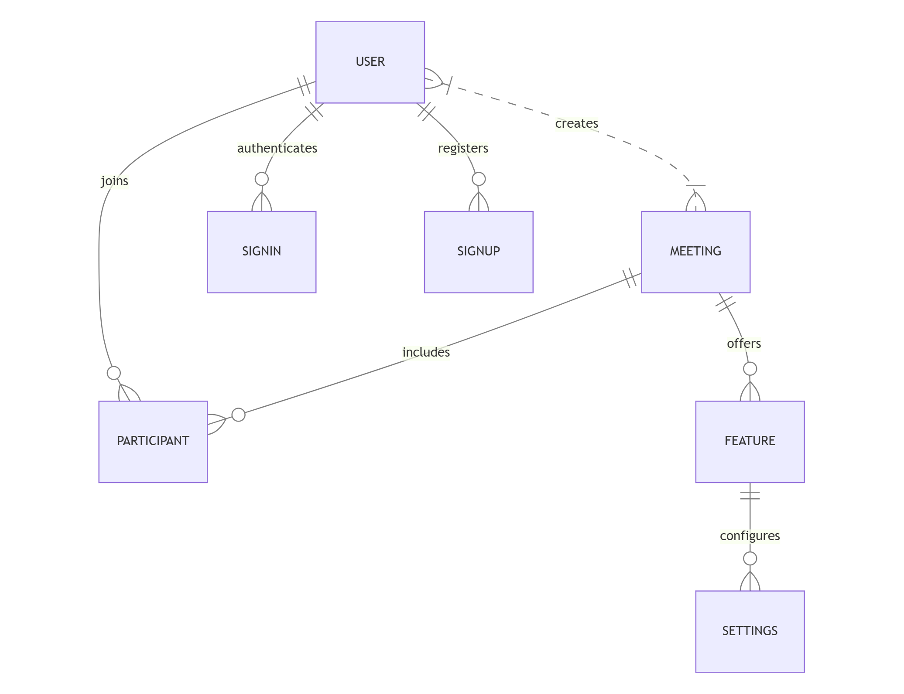
E.R DIAGRAM
Major project Presentation 2025
Organized by: Department of Computer Science & Engineering, GIET, Baniatangi, 752060

Slide 12
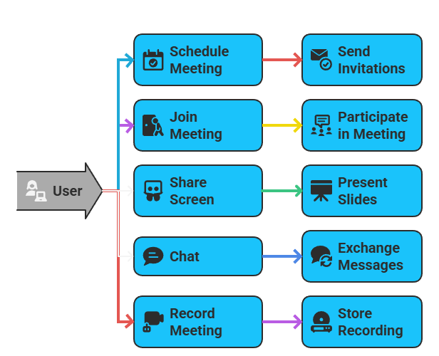
Use case diagram
Major project Presentation 2025
Organized by: Department of Computer Science & Engineering, GIET, Baniatangi, 752060

Slide 13

PROS
*Accessibility and Cost Efficiency*: Online meeting services allow participants to connect from anywhere.
*Enhanced Collaboration Tools*: Features like video conferencing, screen sharing, and chat enable seamless communication and teamwork.
*Recording and Documentation*: Meetings can be recorded for future reference, ensuring no information is lost.
*Scalability and Flexibility*: Suitable for small team meetings.
*Integrated Scheduling and Productivity*: Calendar integration and scheduling tools simplify planning.
Major project Presentation 2025
Organized by: Department of Computer Science & Engineering, GIET, Baniatangi, 752060

Slide 14
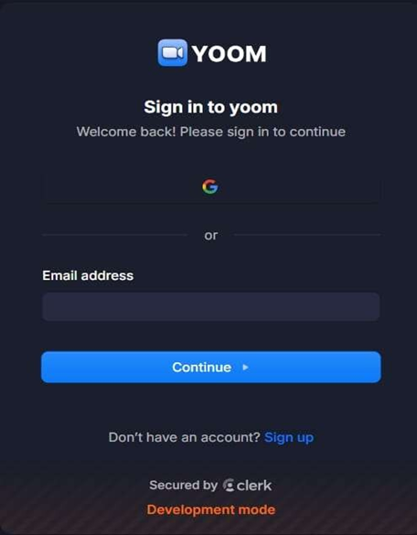
GLANCE YOOM
A "glance yoom" in an online meeting service refers to the ability to quickly and efficiently access a snapshot view of active meetings, participant engagement, or shared content.
This feature allows users to swiftly navigate between sessions, check attendee statuses, or focus on specific parts of the meeting, such as presentations or speaker highlights.
Commonly supported by user-friendly dashboards or shortcuts, "glance zoom" is particularly useful for hosts managing multiple breakout rooms or participants who need to stay informed during dynamic virtual sessions.
Major project Presentation 2025
Organized by: Department of Computer Science & Engineering, GIET, Baniatangi, 752060

Slide 15
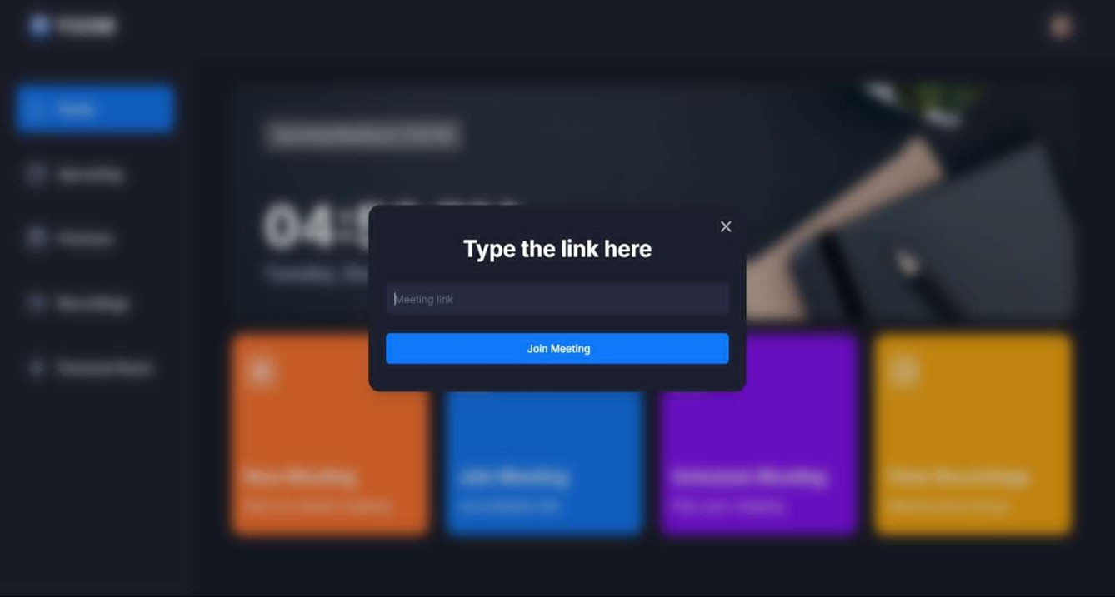
Some Snaps of Our Project
Major project Presentation 2025
Organized by: Department of Computer Science & Engineering, GIET, Baniatangi, 752060

Slide 16
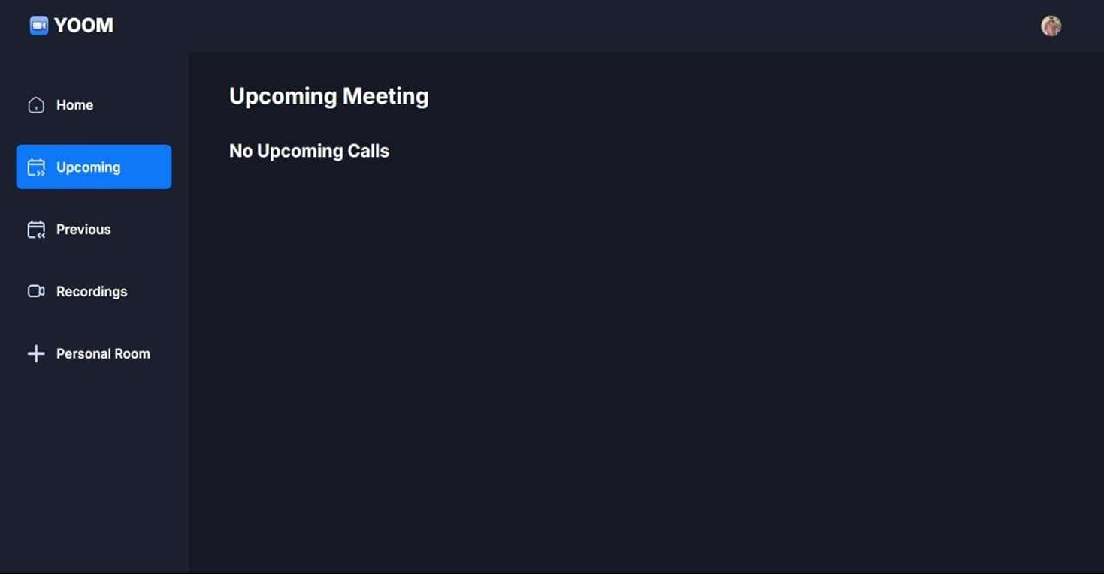
Major project Presentation 2025
Organized by: Department of Computer Science & Engineering, GIET, Baniatangi, 752060

Slide 17
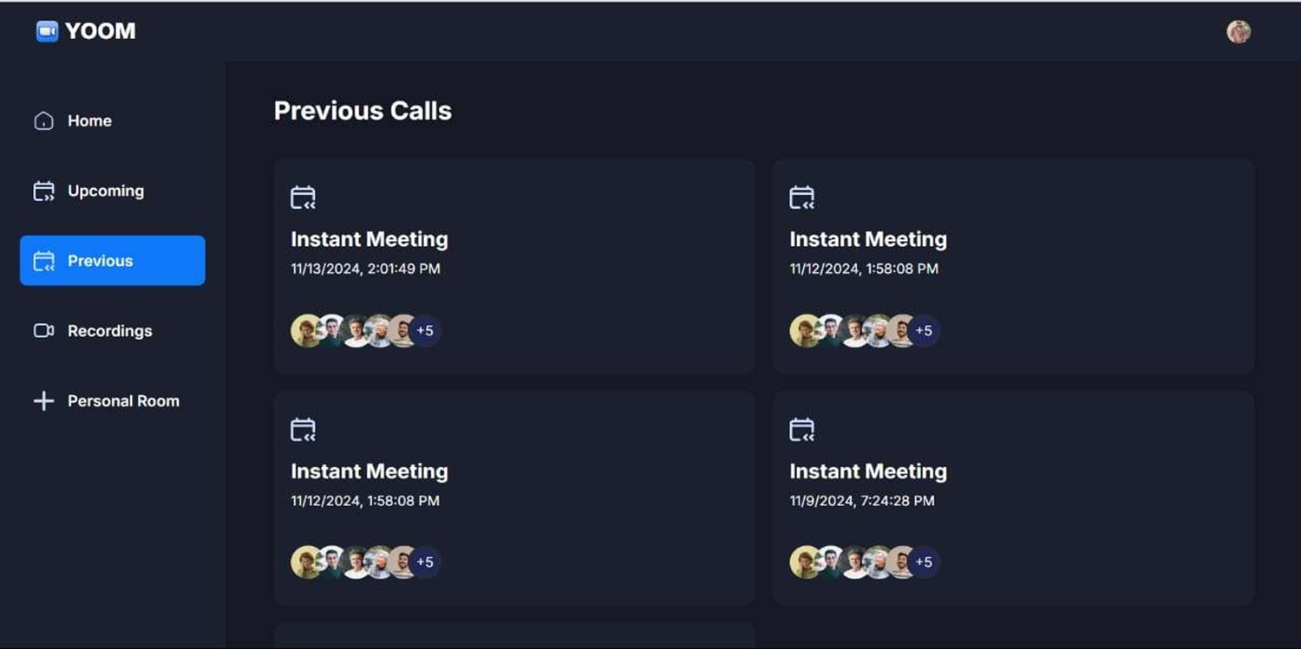
Major project Presentation 2025
Organized by: Department of Computer Science & Engineering, GIET, Baniatangi, 752060

Slide 18
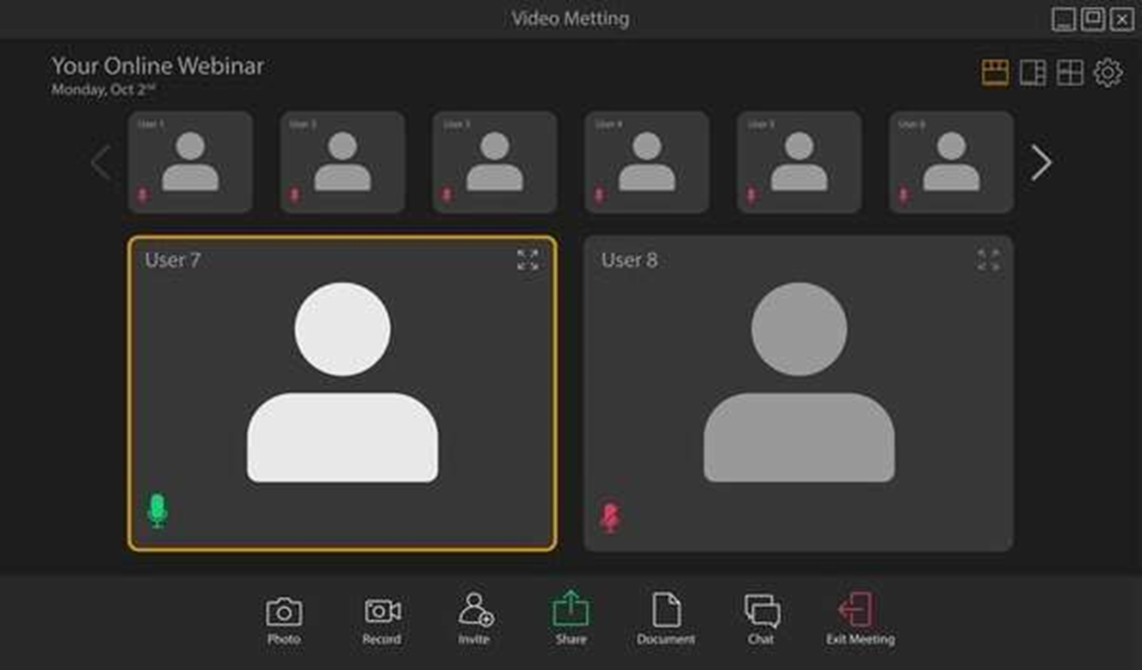
Major project Presentation 2025
Organized by: Department of Computer Science & Engineering, GIET, Baniatangi, 752060

Slide 19
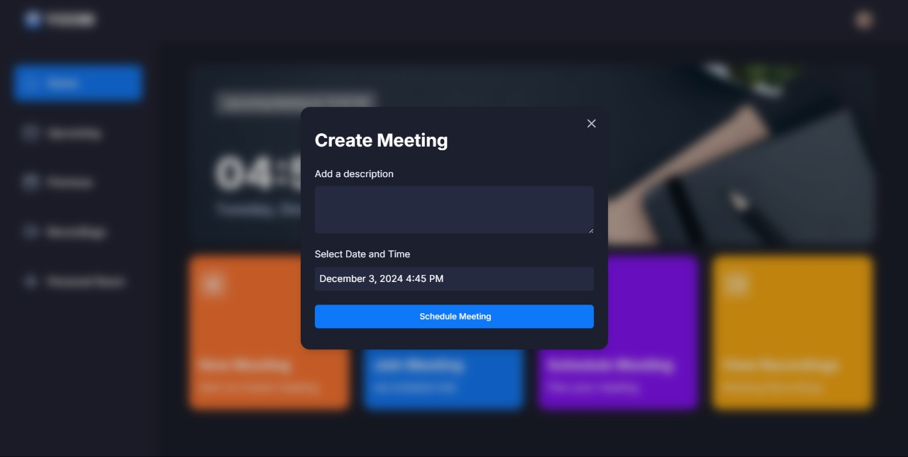
Major project Presentation 2025
Organized by: Department of Computer Science & Engineering, GIET, Baniatangi, 752060

Slide 20
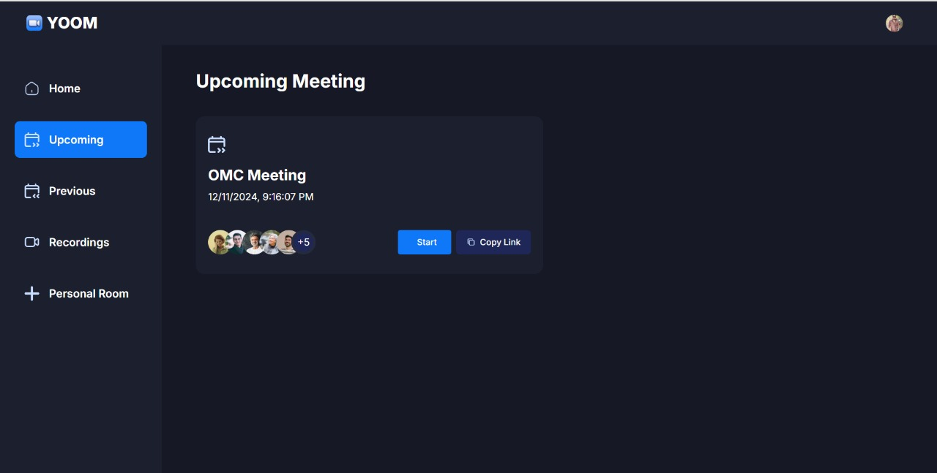
Major project Presentation 2025
Organized by: Department of Computer Science & Engineering, GIET, Baniatangi, 752060

Slide 21

FUTURE SCOPE
The future scope of online meeting services is expansive, driven by advancements in technology and evolving user needs. Artificial intelligence (AI) will enhance features like real-time transcription, language translation, and automated summaries.
Virtual reality (VR) and augmented reality (AR) integration will create immersive meeting experiences, enabling lifelike interactions. Improved security measures will address data privacy concerns, while adaptive bandwidth technologies will ensure seamless connectivity.
Customizable interfaces and analytics will cater to diverse industries, including education, healthcare, and corporate sectors. As hybrid work environments grow, these platforms will continue to innovate, fostering global collaboration, inclusivity, and productivity in an increasingly digital world.
Major project Presentation 2025
Organized by: Department of Computer Science & Engineering, GIET, Baniatangi, 752060

Slide 22
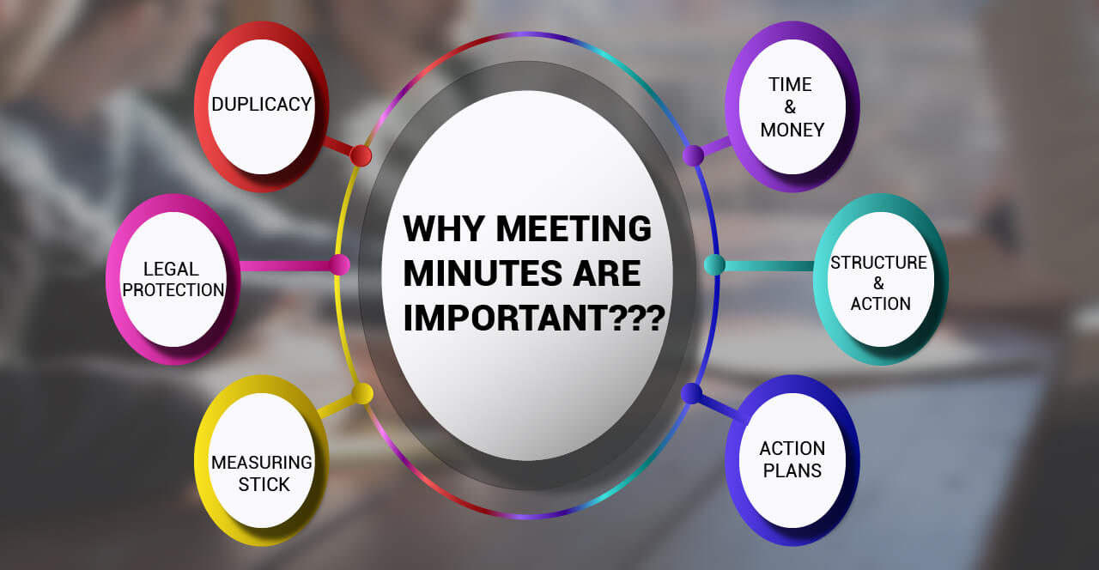
Major project Presentation 2025
Organized by: Department of Computer Science & Engineering, GIET, Baniatangi, 752060

Slide 23

CONCLUSION
In conclusion, online meeting services have transformed the way we collaborate, enabling seamless communication across distances. With features like video conferencing, screen sharing, and real-time chat, these platforms facilitate efficient teamwork, enhance productivity, and reduce travel costs. As technology continues to advance, the future of online meetings will include innovations like AI-powered tools, immersive VR/AR experiences, and improved security measures, further enhancing user experience and accessibility. With the rise of remote and hybrid work environments, online meeting services will remain essential for global collaboration, fostering more flexible, inclusive, and efficient workspaces for businesses and individuals worldwide.
Major project Presentation 2025
Organized by: Department of Computer Science & Engineering, GIET, Baniatangi, 752060

Slide 24
THANK YOU
Major project Presentation 2025
Organized by: Department of Computer Science & Engineering, GIET, Baniatangi, 752060

Slide 25


Major project Presentation 2025
Organized by: Department of Computer Science & Engineering, GIET, Baniatangi, 752060

